Slide 1
22.2 ELASTIC LOAD BALANCER
INTRODUCTION:
Elastic Load Balancing automatically distributes incoming traffic across multiple EC2 instances.
You create a load balancer and register instances with the load balancer in one or more Availability Zones.
The load balancer serves as a single point of contact for clients.
This enables you to increase the availability of your application.
You can add and remove EC2 instances from your load balancer as, without disrupting the overall flow of traffic.
If an EC2 instance fails, Elastic Load Balancing automatically reroutes the traffic to the remaining running EC2 instances.
If a failed EC2 instance is restored, Elastic Load Balancing restores the traffic to that instance.
Elastic Load Balancing can also serve as the first line of defence against attacks on your network.
Features of Elastic Load Balancing:
Features of Elastic Load Balancing Elastic Load Balancing provides the following features:
You can use the operating systems and instance types supported by Amazon
EC2.You can configure your EC2 instances to accept traffic only from your load balancer.
You can configure the load balancer to accept traffic using the following protocols: HTTP, HTTPS (secure HTTP), TCP, and SSL (secure TCP).
You can configure your load balancer to distribute requests to EC2 instances in
multiple Availability Zones, minimizing the risk of overloading one single instance. If an entire Availability Zone goes offline, the load balancer routes traffic to instances in other Availability Zones.
There is no limit on the number of connections that your load balancer can
attempt to make with your EC2 instances. The number of connections scales with the number of concurrent requests that the load balancer receives.

Slide 2
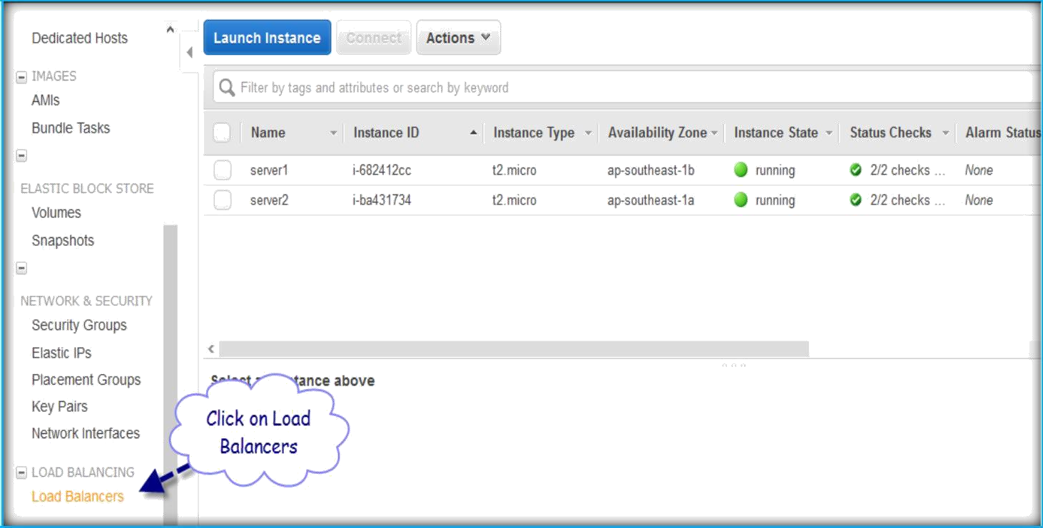
You can configure the health checks that Elastic Load Balancing uses to monitor the health of the EC2 instances registered with the load balancer so that it can send requests only to the healthy instances.
You can use end-to-end traffic encryption on those networks that use secure (HTTPS/SSL) connections.
CREATE ELASTIC LOAD BALANCER
Once logged into AWS, go to EC2 section.
In EC2 page select Load Balancers under Load Balancing menu from the left pane.
Then click on Create Load Balancer to create a new one.

Slide 3
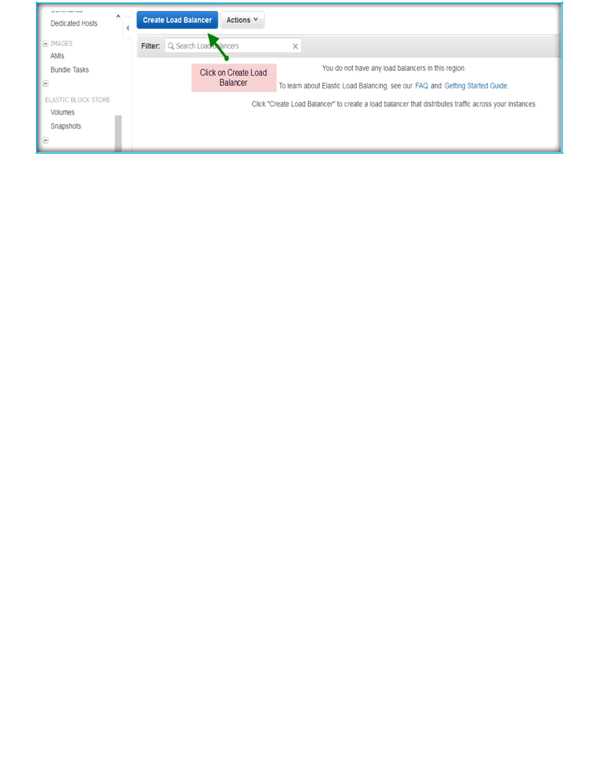
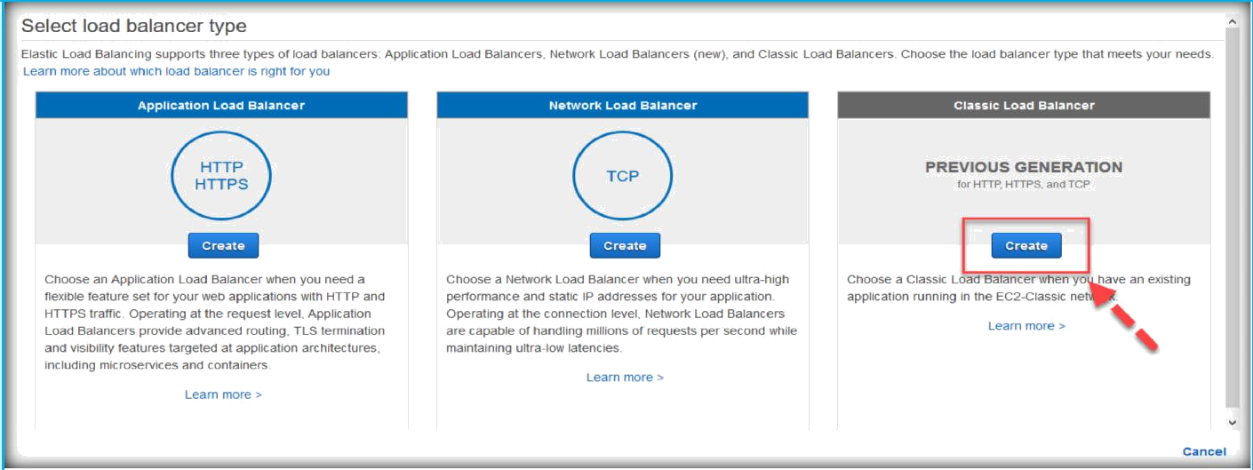
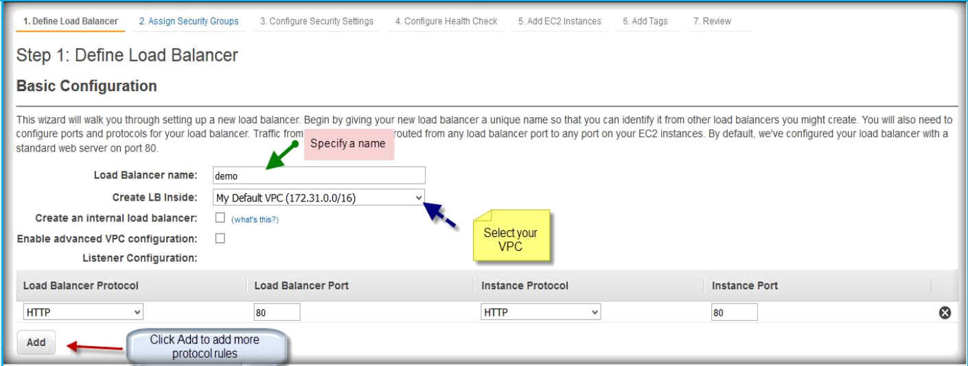
Click on Create under Classic Load Balancer.
In the next page Specify a name to your load balancer, select VPC from Create LB inside drop down list.
Then click on Add button which is below the protocol rules to add more rules.
Once you clicked on Add button, select Load balancer protocol from drop down list.

Slide 4
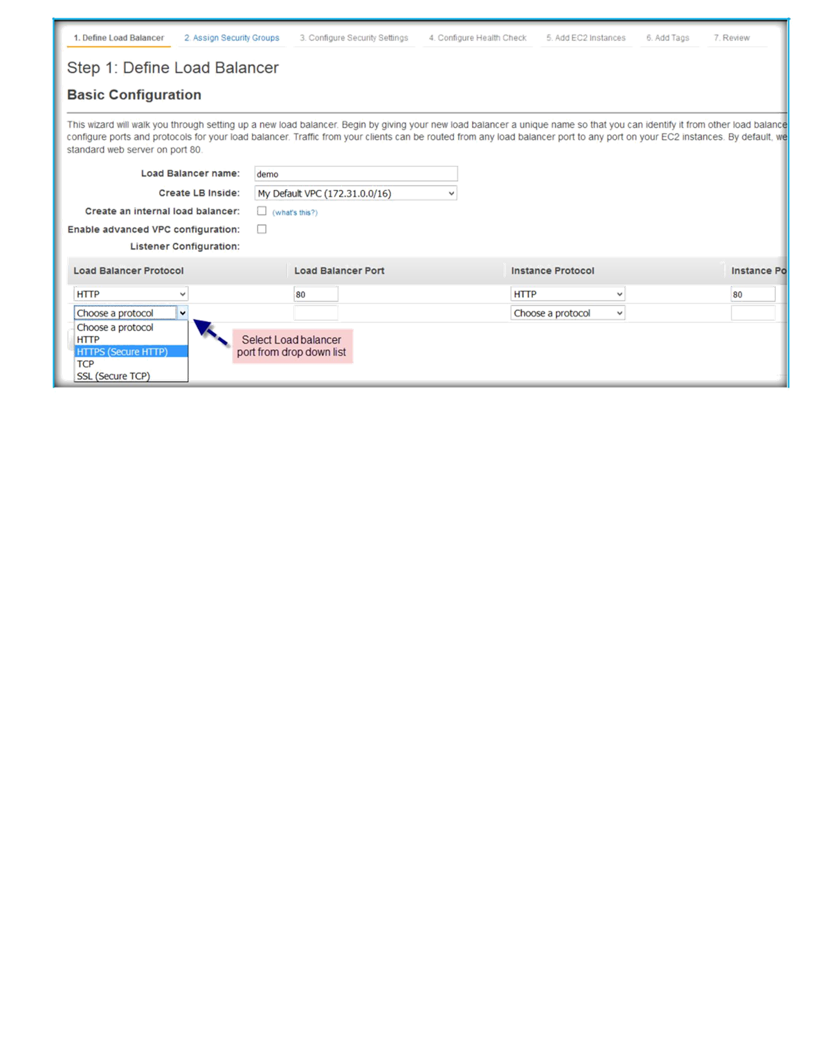
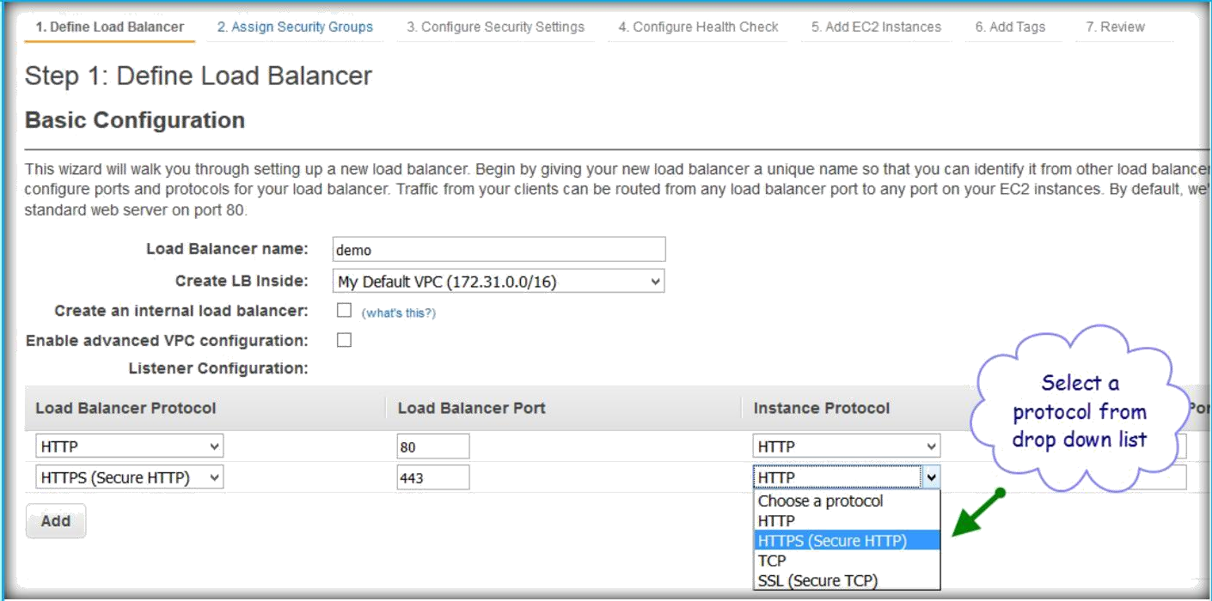
Select instance protocol from drop down list.
Then click on Next button after specifying both Load balancer and Instance protocols.

Slide 5
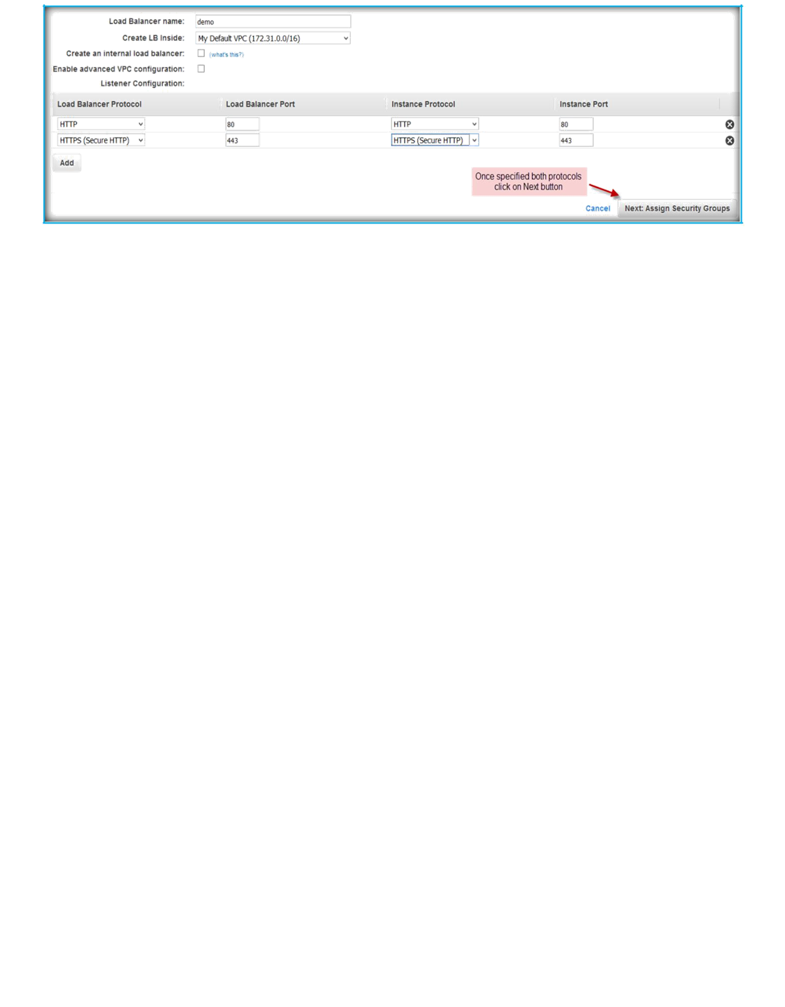
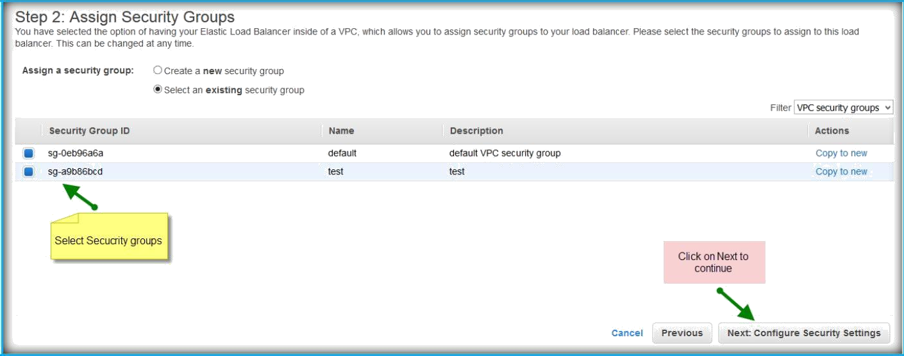
In the next page select security groups you want to assign to ELB or create a new one and select, then click on Next to continue.
If you have SSL certificate for your domain, you can paste that information in the coming page.
Specify a name for your certificate, paste your private key in Private key box text field, paste your public key in Public key certificate text field, and paste if you have a SSL certificate chain.

Slide 6
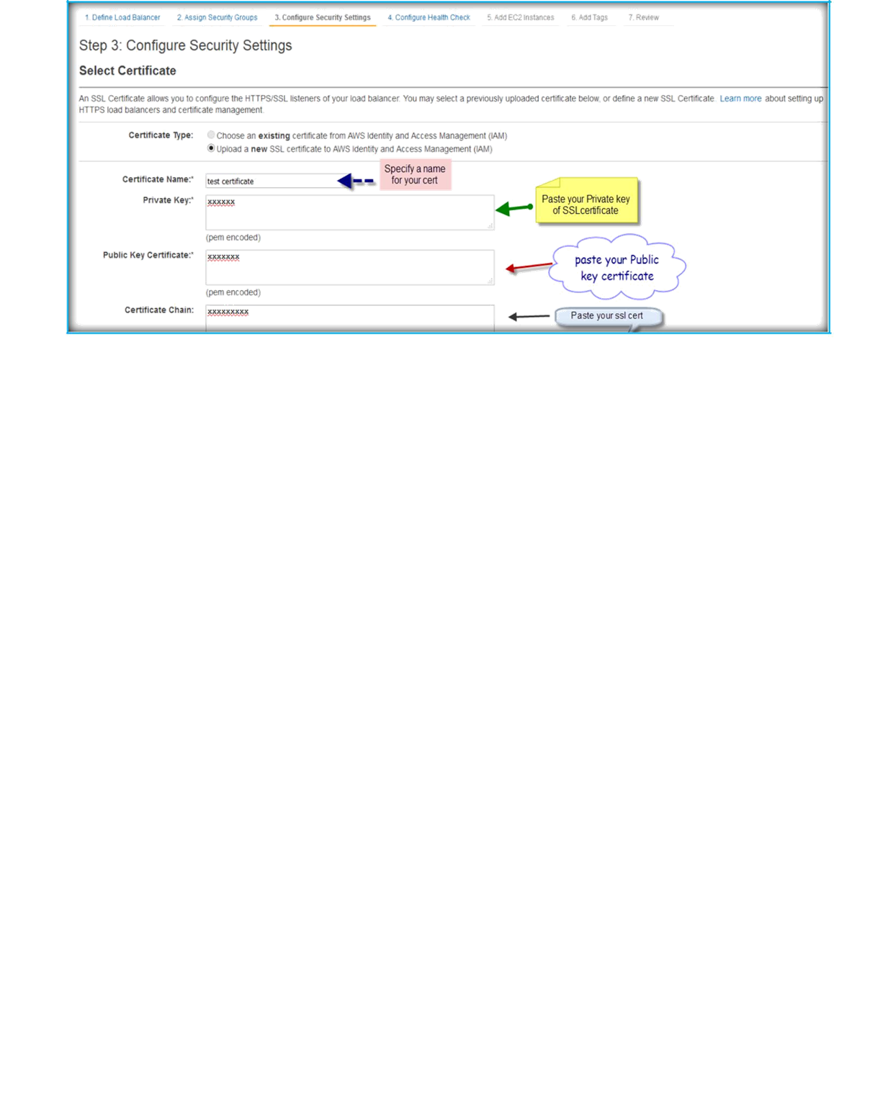
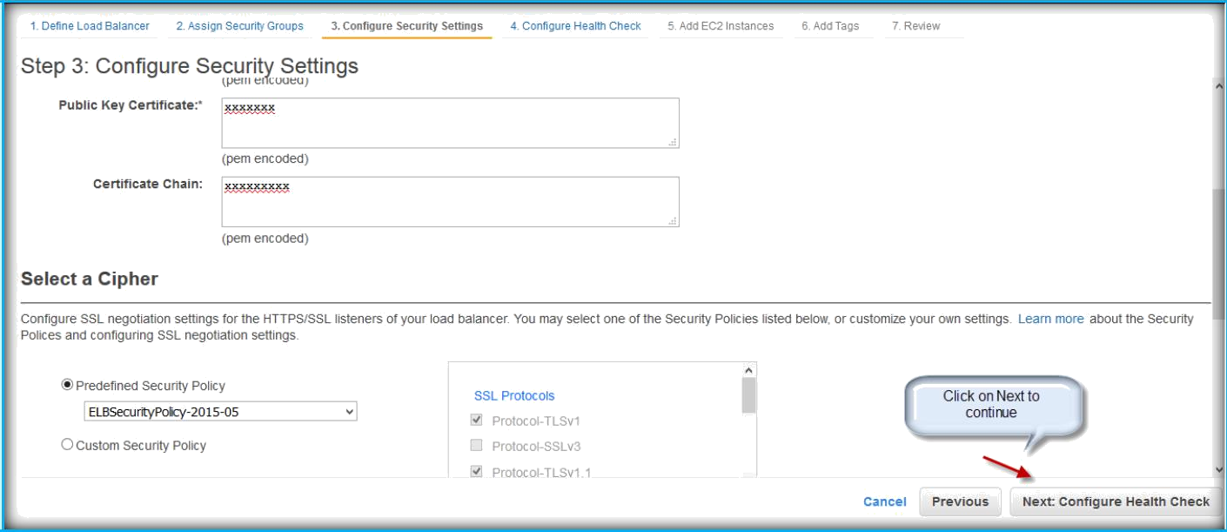
Then come below of the same page and click on Next to continue.
Now we need to configure health checks.
Ping Protocol: The protocol to use to connect with the instance. Valid values: TCP, HTTP, HTTPS, and SSL
Ping Port: The port to use to connect with the instance, and check the availability. If the load balancer fails to connect with the instance at the specified port within the configured response timeout period, the instance is considered unhealthy.
Ping Path: The destination for the HTTP or HTTPS request.

Slide 7
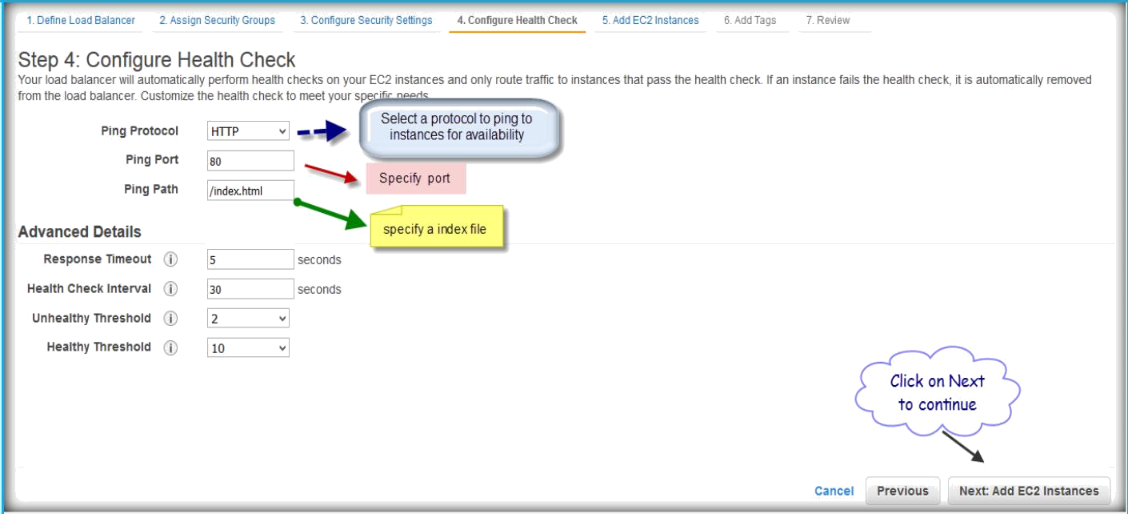
Response Timeout: The amount of time to wait when receiving a response from the health check, in seconds. Valid values: 2 to 60
HealthCheck Interval: The amount of time between health checks of an individual instance, in seconds. Valid values: 5 to 300
Unhealthy Threshold: The number of consecutive failed health checks that must occur before declaring an EC2 instance unhealthy. Valid values: 2 to 10
Healthy Threshold: The number of consecutive successful health checks that must occur before declaring an EC2 instance healthy. Valid values: 2 to 10
Then click on Next to continue.
Then select your instances from the instances list and click next.

Slide 8
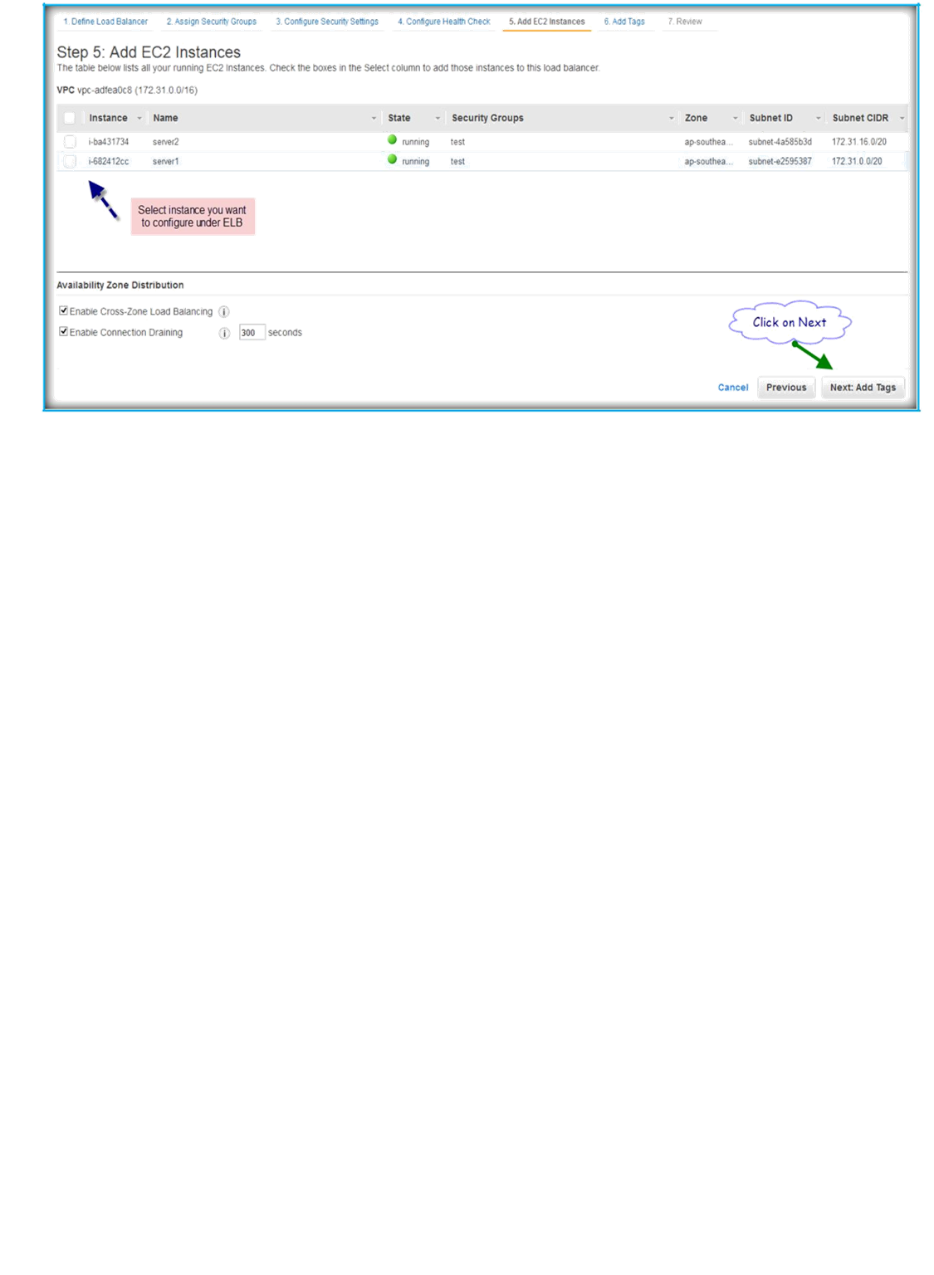
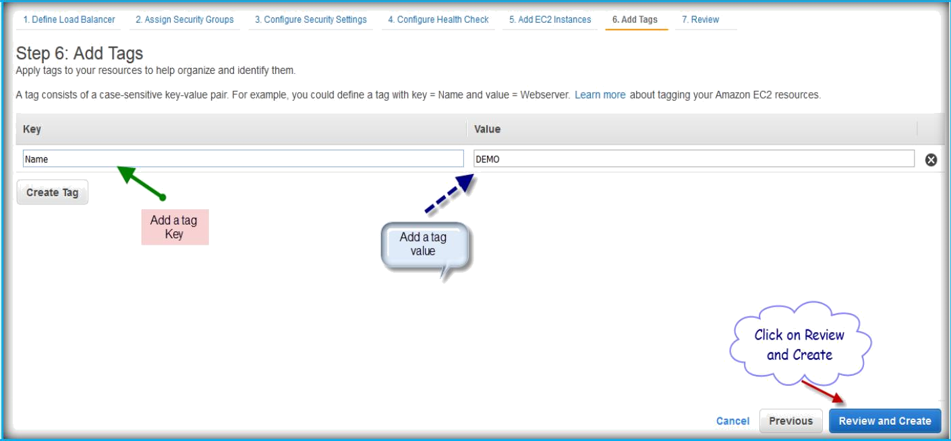
Specify a Tag name and specify a tag value, then click on below button Review and Create.
Check your settings before submitting your changes and then click Create button below.

Slide 9
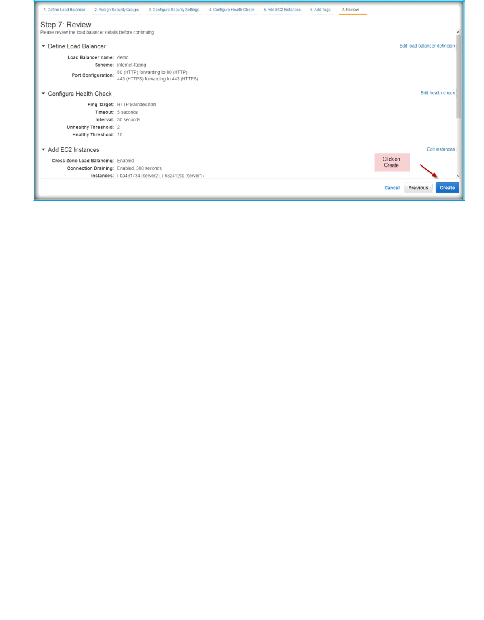
After completion of creation process of ELB you can find it under the ELB section on EC2 page.

